Slide 1
ME469: Multiphase Methods: Volume of Fluid Methods
Stefan P. Domino^{1,2}
¹ Computational Thermal and Fluid Mechanics, Sandia National Laboratories
² Institute for Computational and Mathematical Engineering, Stanford
SAND2018-4536 PE

Slide 2
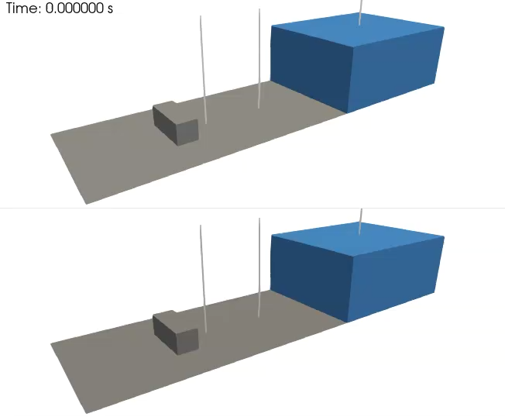
Objective: Model Multiphase Flow (Air/Water)
Validation case of Kleefsman et al. ”A volume-of-fluid based simulation method for wave impact problems”, J. Comput. Phys. (2005).
See:
/laboratory/3d_hex8_dam_break
(nuances associated with top and bottom simulation will be captured later in the lecture)

Slide 3
Goals:
What multiphase method: Volume of Fluid (VOF) or level set? (sometimes VoF)
Consistency established via a “balanced force scheme”
Verification for VOF equation
Using routine and improved advection operators
Surface sharpening
Capillary instability
All together for general air/liquid modeling and simulation
Validation

Slide 4
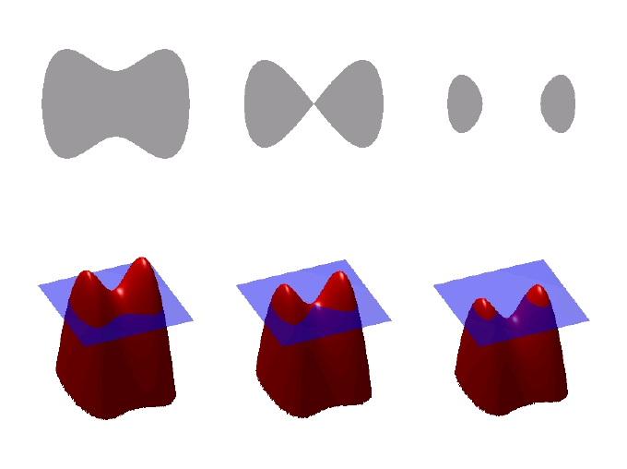
Step 1: Definition of an Air/Liquid Interface (Phase 1/Phase 2)
Signed-distance function (level-set), Ψ
Popularized by Osher and Sethian, “Fronts propagating with curvature-dependent speed: Algorithms based on Hamilton-Jacobi formulations”, J. Comp. Phys., 1988,
Volume of Fluid, φ or α
Lineage classically provided to Noh, W.F.; Woodward, P. (1976). van de Vooren, A.I.; Zandbergen, P.J. (eds.). SLIC (Simple Line Interface Calculation). proceedings of 5th International Conference of Fluid Dynamics. Lecture Notes in Physics. Vol. 59. pp. 330–340
Interpretation: volume fraction of phase 1, interphase lives at ½
defines an zero-isocontour, with distance
(+/- in either direction)
Interface normal and curvature

Slide 5
Step 1: Definition of an Air/Liquid Interface (Phase 1/Phase 2)
Signed-distance function (level-set), Ψ
Popularized by Osher and Sethian, “Fronts propagating with curvature-dependent speed: Algorithms based on Hamilton-Jacobi formulations”, J. Comp. Phys. (1988)
Volume of Fluid, φ or α
Lineage classically provided to Noh, W.F.; Woodward, P. (1976). van de Vooren, A.I.; Zandbergen, P.J. (eds.). SLIC (Simple Line Interface Calculation). proceedings of 5th International Conference of Fluid Dynamics. Lecture Notes in Physics. Vol. 59. pp. 330–340
Interpretation: volume fraction of phase 1, interphase lives at ½
defines an zero-isocontour, with distance
(+/- in either direction)
Interface normal and curvature

Slide 6
VOF Transport Discretization Nuance: Volume- or Surface-based?
Simple enough, define the volume (fraction) of fluid (absent evaporation):
Option 1: volumetric-form:
Option 2: divergence-form:
CVFEM/FEM (really, any element-based approach)
Evaluated as a volumetric-contribution (diamonds)
Gauss-Divergence
Traditional finite volume (element, edge, cell-centered)
Evaluated as a surface integral (triangle)
Allows for a consistent advecting velocity (mass conserving)
that is obtained from the continuity equation

Slide 7
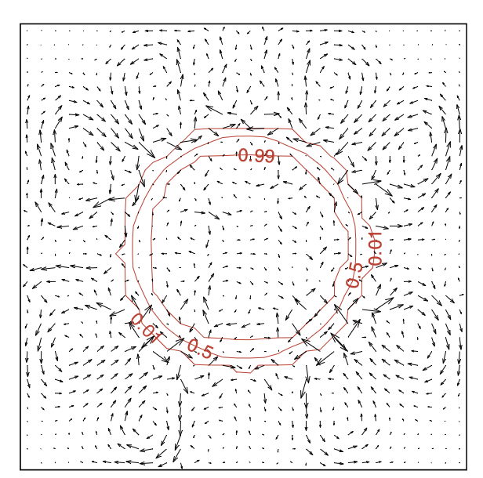
Equal-Order Interpolation, i.e., Collocation: Q: If F_{i} includes surface tension, however, ${\hat{u}}_{j}$ does not, then what?
Lack of consistency between continuity and momentum system leads to parasitic currents – even for a static bubble arrangement
Goal: static equilibrium where surface tension balances pressure gradient perfectly
and κ are surface tension and curvature
(recall, interface normal), see: Brackbill et al.
“A continuum method for modeling surface
tension”, J. Comp. Phys. (1992)
Harvie et al. “An analysis of parasitic current generation
in Volume of Fluid simulations”, App. Math. Modeling (2006)

Slide 8
Equal-Order Interpolation, i.e., Collocation: Pressure Stabilization Review
is a function of the fine-scale momentum residual (evaluated at an integration point):
We can also project this residual to the nodes, and approximate R^{h}(u_{j}) as re-interpolation of choice terms
Usage of a full residual (1) results in a classic Pressure Stabilized Petrov Galerkin (Hughes et al. 1986)
Pick and choose each residual, Majumdar (1988)
Algebraically manipulation affords the classic Rhie-Chow-based (1983) pressure stabilization
- shown to be stable and dissipative [Ham and Iaccarino (2004) or Domino (2006)]
There is also the nuance of pressure projection vs monolithic
(1)
~(L-DG)

Slide 9
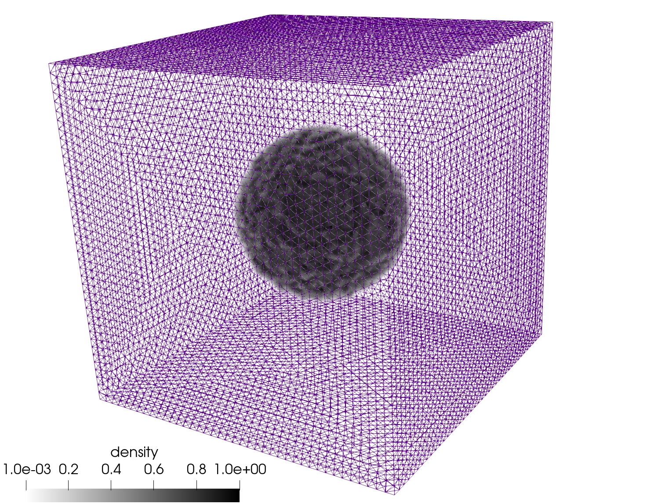
VOF using Balanced Force: Brief Survey
Classic Balanced Force, Francois, J. Comput. Phys. (2006)
First CVFEM: Lin et al, J. Comput. Phys. (2019)
Parasitic currents suppressed via a consistent momentum/continuity stabilization form: fine-scale momentum residual algebraically modified in continuity equation
Static bubble ρ →1000:1
Nodal pressure gradient
Momentum Equation
Convecting-velocity
Continuity Equation
Note: benefits from ρg_{i} (γ = 1) included in stabilization

Slide 10
VOF using Balanced Force: Brief Survey
Classic Balanced Force, Francois, J. Comput. Phys. (2006)
First CVFEM: Lin et al, J. Comput. Phys. (2019)
Parasitic currents suppressed via a consistent momentum/continuity stabilization form: fine-scale momentum residual algebraically modified in continuity equation
Static bubble ρ →1000:1
Surface tension Continuum Surface Force (CSF)
Momentum Equation
Continuity Equation
Note: benefits from ρg_{i} (γ = 1) included in stabilization

Slide 11
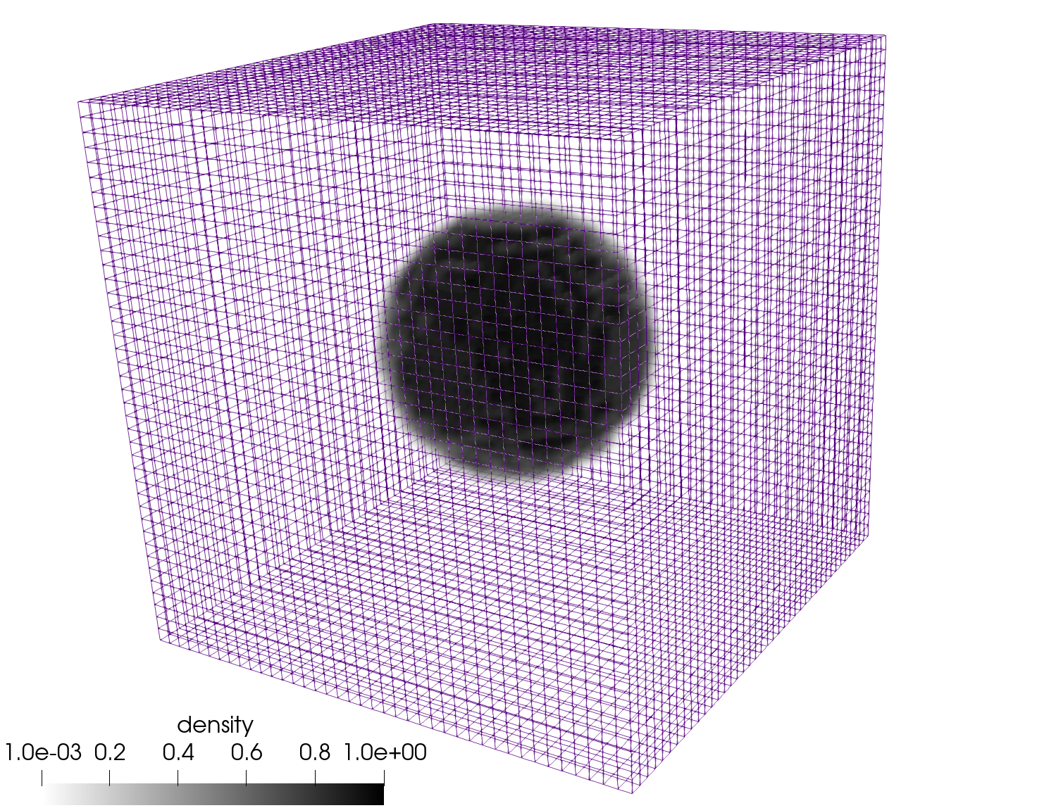
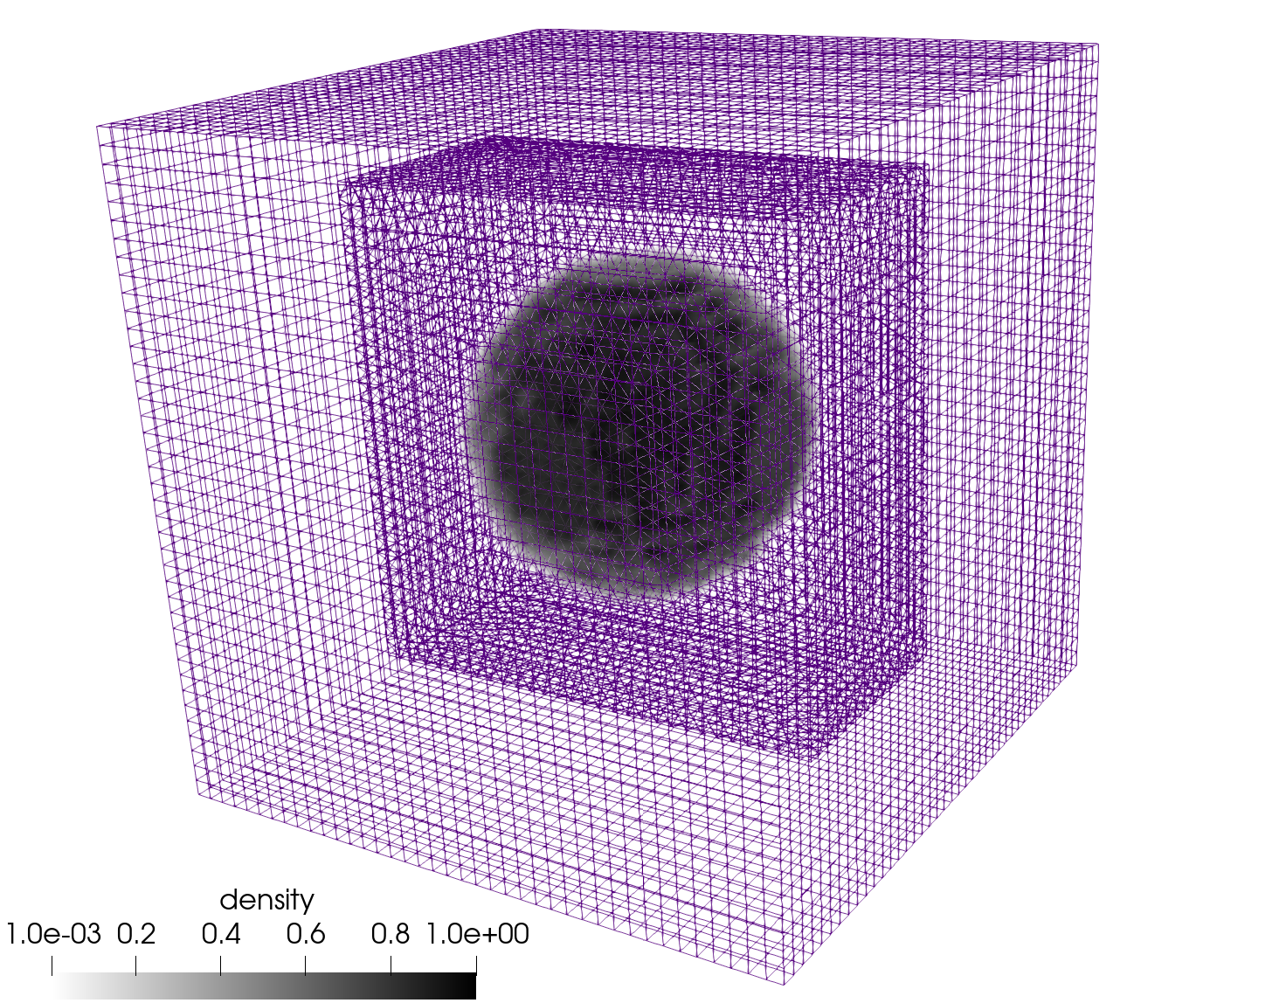
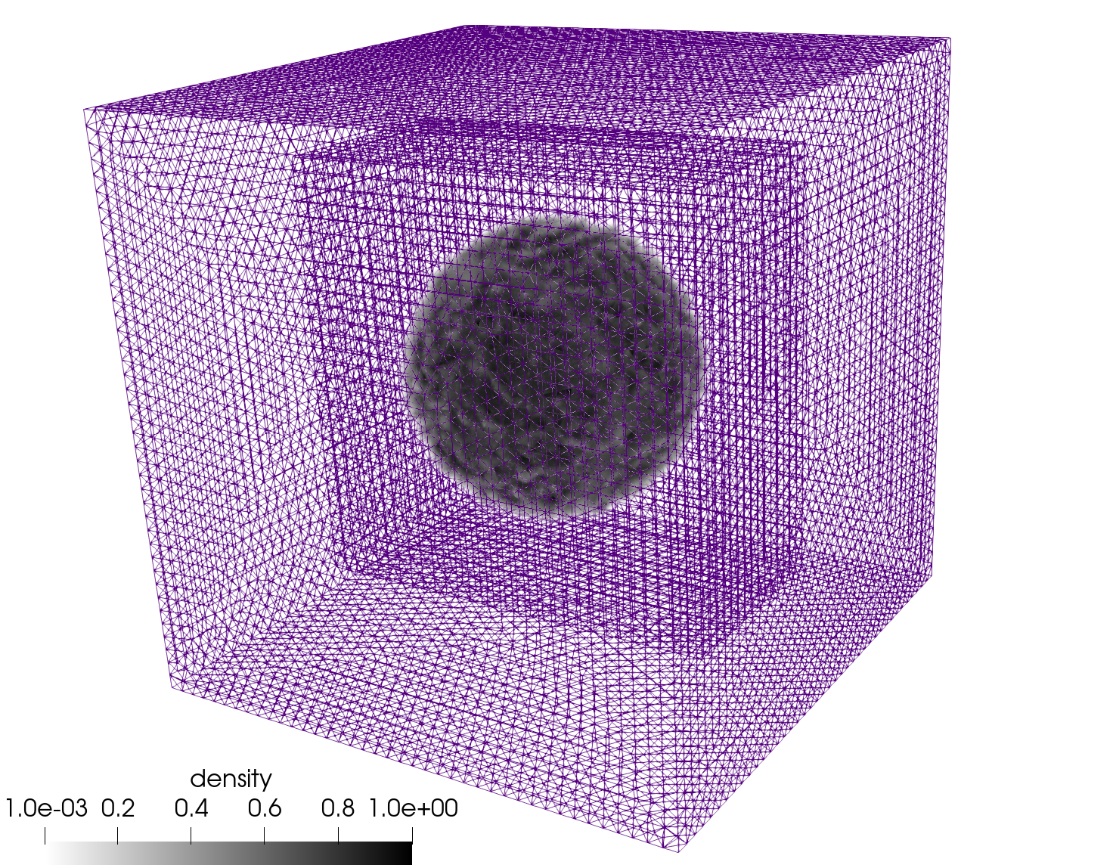
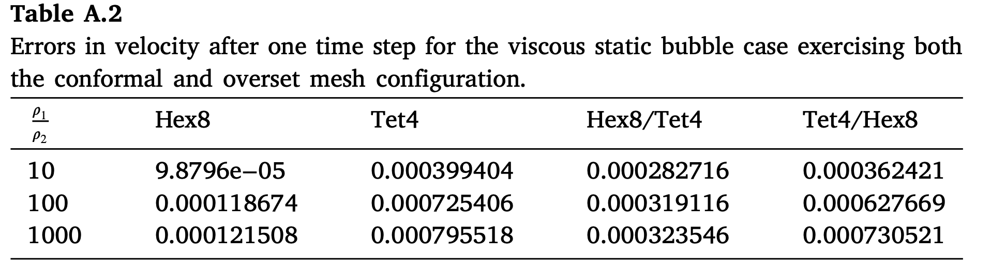
Common “Verification test”
Static bubble (image shown for the density ratio 1000:1)
Hex8, Tet4, Hex8/Tet4, Tet4./Hex8

Slide 12
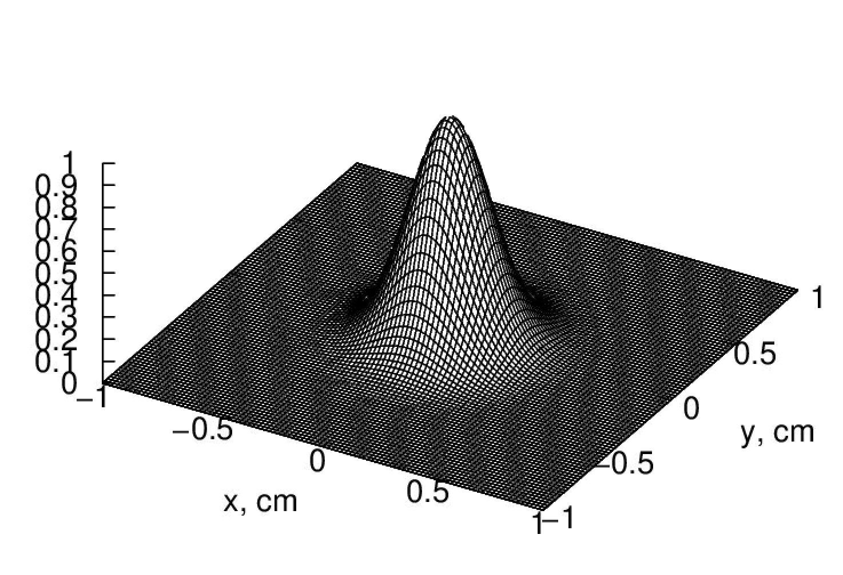
Simple Verification Test for:
Molenkamp verification, see Martinez, Int. J. Numer. Meth. Engr. (2004), shown below with a variety of stabilization options
Conformal mesh results
(stay tuned for overset)
First-order, upwind (FOUPW)
Second-order, UPW+Limit (SOUPW, limit)
SUCV, Polynomial-order = 1
SUCV, Polynomial-order = 2

Slide 13
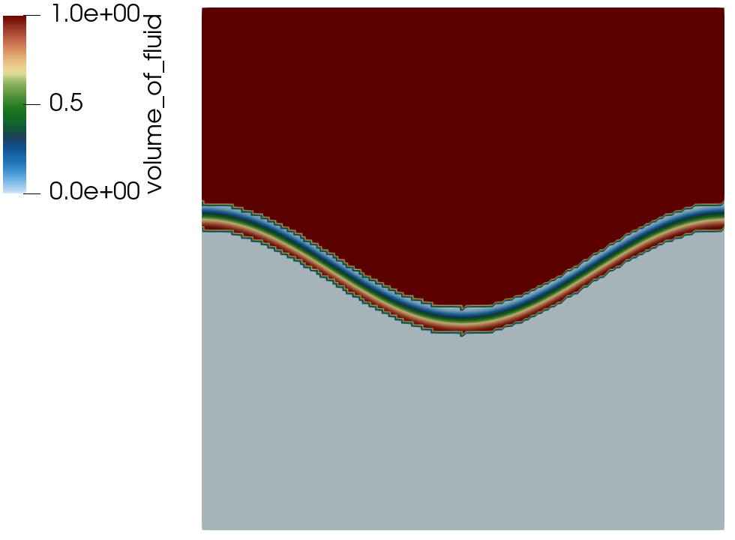
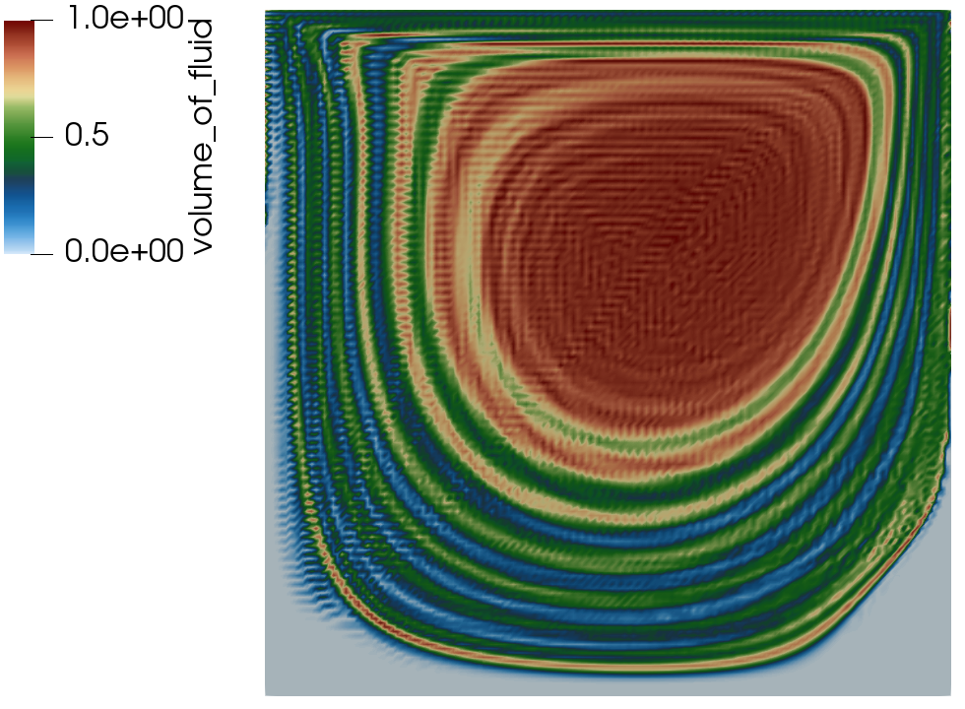
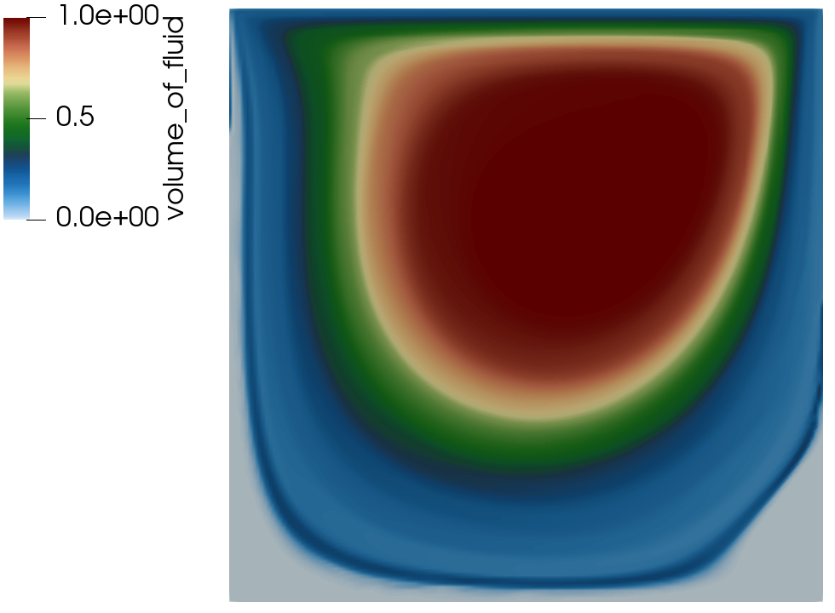
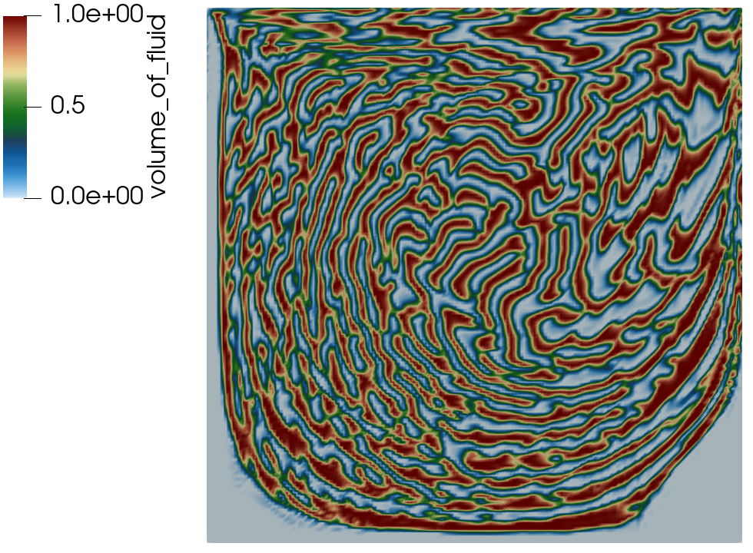
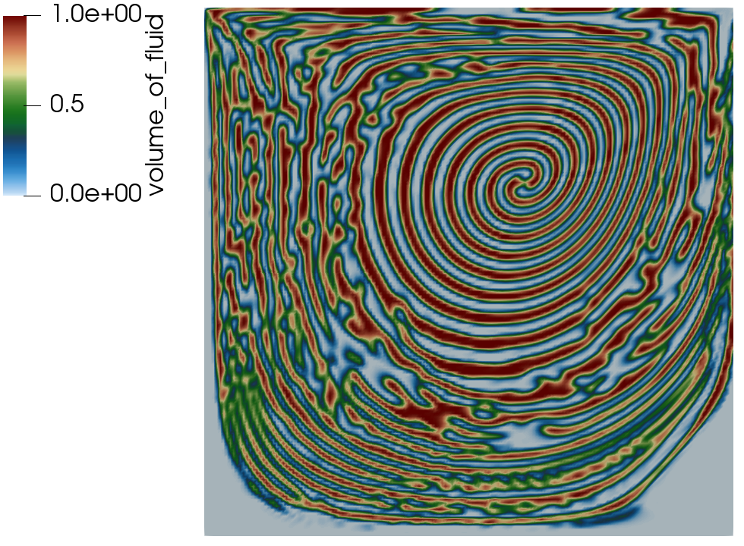
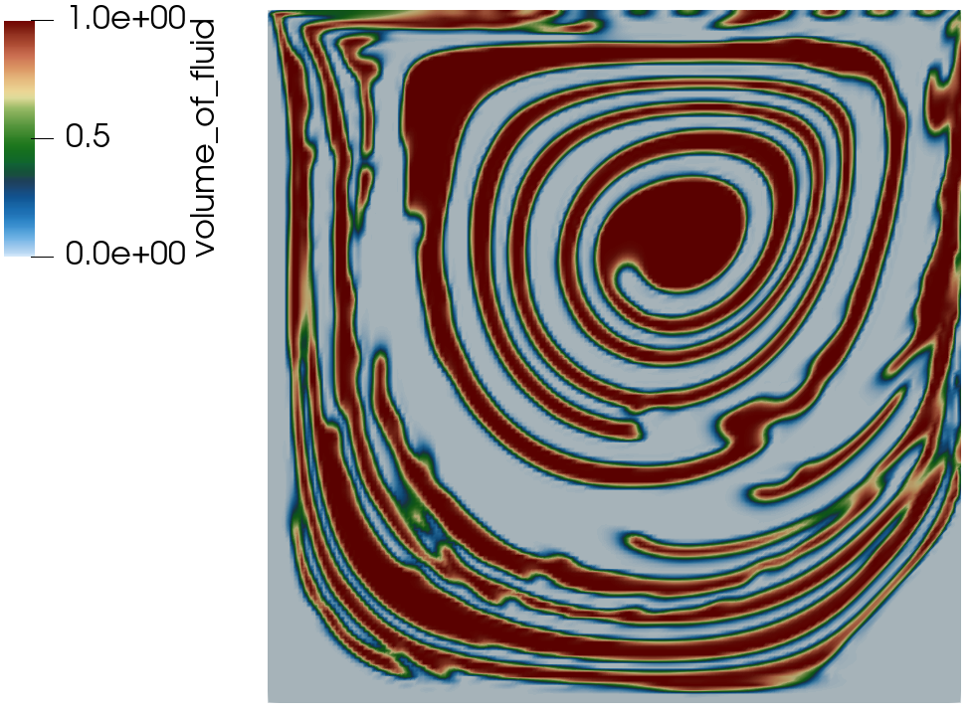
Passive Transport Example: Driven Cavity
Exploring PDE-based sharpening, interface smoothing and stabilization
Initial condition
No stabilization
SUCV+NSO
Sharpening+B
Sharpen+C
E+Smoothing
A B C
D E F

Slide 14
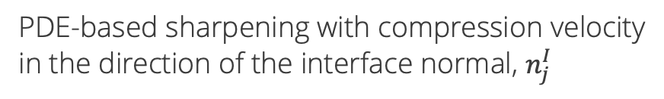
VOF Transport: Sharpening + Advection Stabilization + Interface Smoothing
VOF equation with PDE-based sharpening (to mitigate numerical diffusion) that includes residual-based stabilization
Integrated-by-parts advection to allow for consistent continuity constraint; R^{h}(α)
PDE-based sharpening with compression velocity
in the direction of the interface normal, $n_{j}^{I}$
Streamwise-upwind, control volume (SUCV), Swaminanthan et al., Int. J. Numer.
Meth. Engr. (1993); based on Streamwise Upwind Petrov-Galerkin (SUPG),
Brooks and Hughes, Comput. Methods in Appl. Mech. Eng. (1982).
Nonlinear stabilization operator (NSO); Motivated by Shakib et. al, Comput.
Methods in Appl. Mech. Eng. (1991), discontinuity capturing operator
(later termed NSO); ν^{h} = f(R^{h}(α)) NSO and SUCV avoids common gradient
reconstruction techniques commonly used in unstructured formulations, see
Tsui et al., Int. J. Heat Mass Trans. (2009)
Nuance: interface normal can be computed using a smoothed VOF field

Slide 15
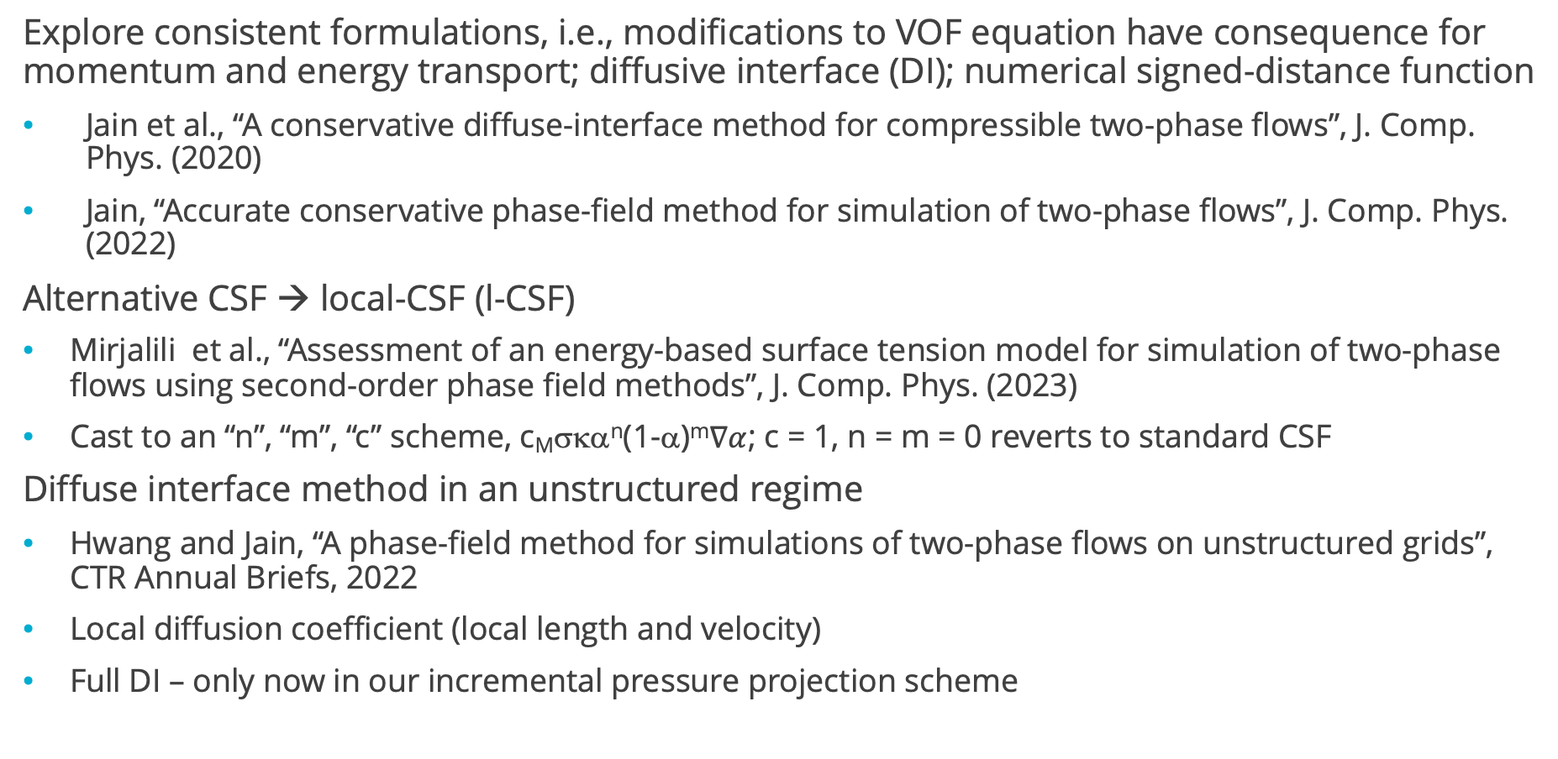
Alternative Baseline Formulation:
Explore consistent formulations, i.e., modifications to VOF equation have consequence for momentum and energy transport; diffusive interface (DI); numerical signed-distance function
Jain et al., “A conservative diffuse-interface method for compressible two-phase flows”, J. Comp. Phys. (2020)
Jain, “Accurate conservative phase-field method for simulation of two-phase flows”, J. Comp. Phys. (2022)
Alternative CSF → local-CSF (l-CSF)
Mirjalili et al., “Assessment of an energy-based surface tension model for simulation of two-phase flows using second-order phase field methods”, J. Comp. Phys. (2023)
Cast to an “n”, “m”, “c” scheme, c_{M}σκα^{n}(1-α)^{m}$∇α$; c = 1, n = m = 0 reverts to standard CSF
Diffuse interface method in an unstructured regime
Hwang and Jain, “A phase-field method for simulations of two-phase flows on unstructured grids”, CTR Annual Briefs, 2022
Local diffusion coefficient (local length and velocity)
Full DI – only now in our incremental pressure projection scheme
+

Slide 16

Dam Break Validation: The Benefit of a Full Balanced-Force Method
Here, comparisons made between γ = 1 (top) and γ = 0 (bottom) showcasing the increased stabilizing effect of the set of all body forces in momentum included in the pressure stabilization formulation
A nuance briefly captured and/or hinted at in seminal Francois et al., J. Comput. Phys. (2006) effort
R0

Slide 17
Dam Break Validation: The Benefit of a Full Balanced-Force Method
Here, comparisons made between γ = 1 (top) and γ = 0 (bottom) showcasing the increased stabilizing effect of the set of all body forces in momentum included in the pressure stabilization formulation
A nuance briefly captured and/or hinted at in seminal Francois et al., J. Comput. Phys. (2006) effort
R2

Slide 18
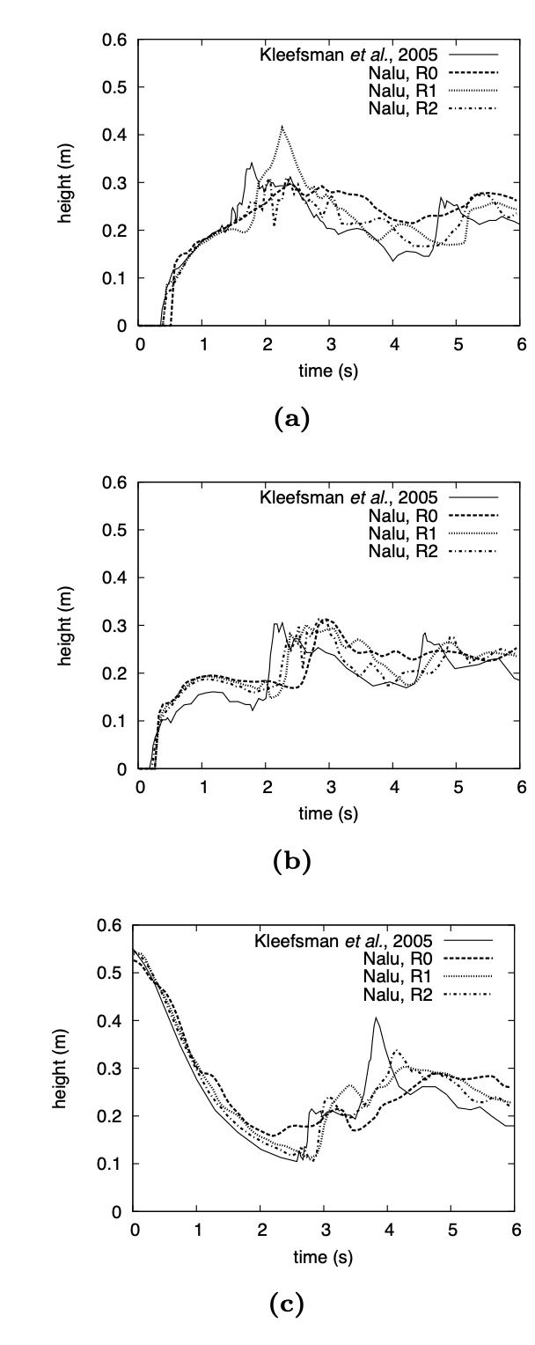
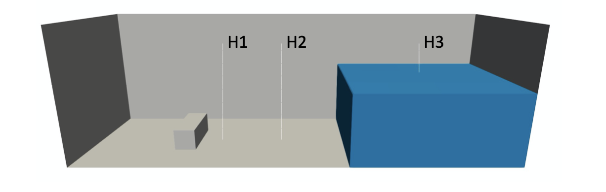
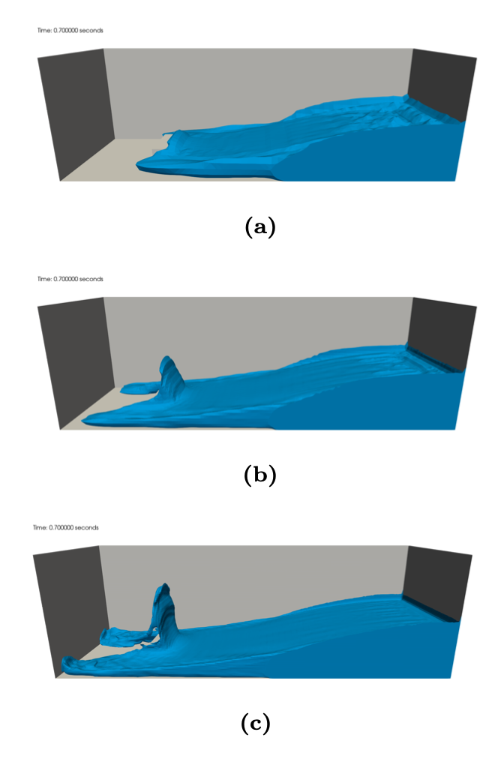
Dam Break Validation
H1
Validation case of Kleefsman et al. ”A volume-of-fluid based simulation method for wave impact problems”, J. Comput. Phys. (2005).
Qualitative comparisons also made to SNL’s Sierra/Fuego, Brown et al. “Modeling a rubble fire consisting of comingled liquid and solid fuel”, Tech. Rep. SAND2017- 12318C (2017).
R0
H2
R1
R2
H3

Slide 19
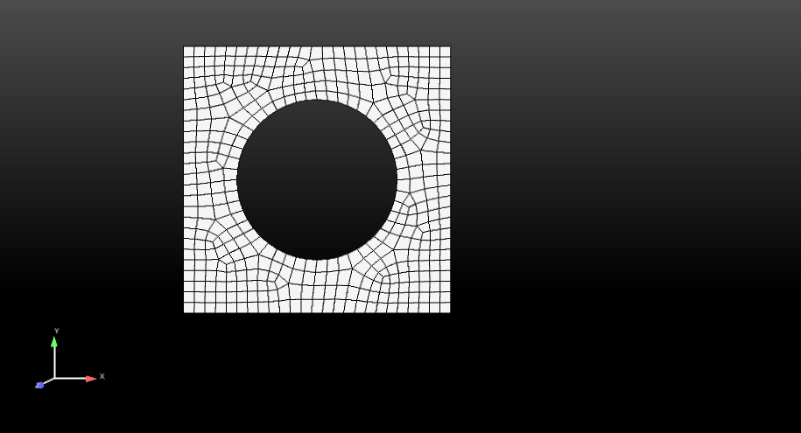
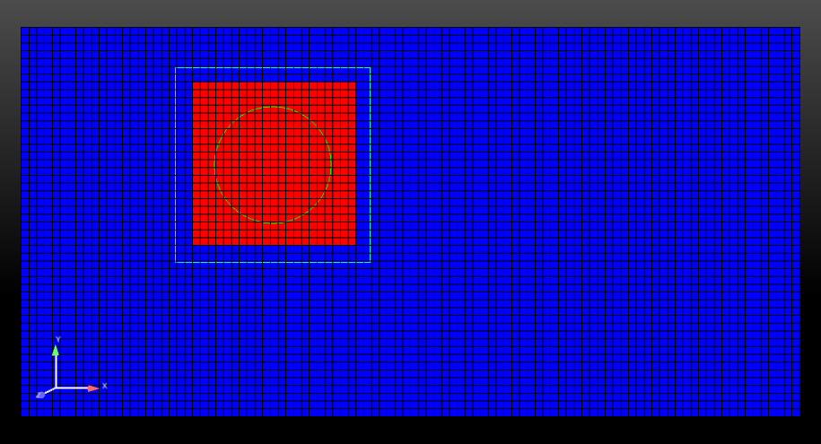
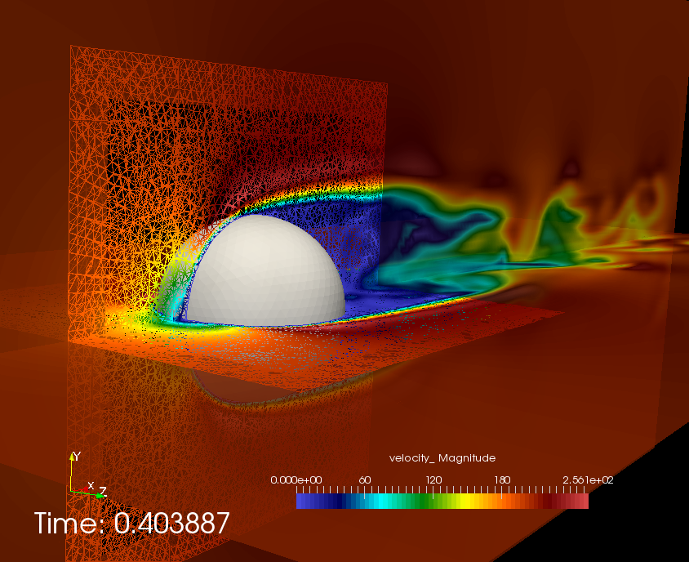
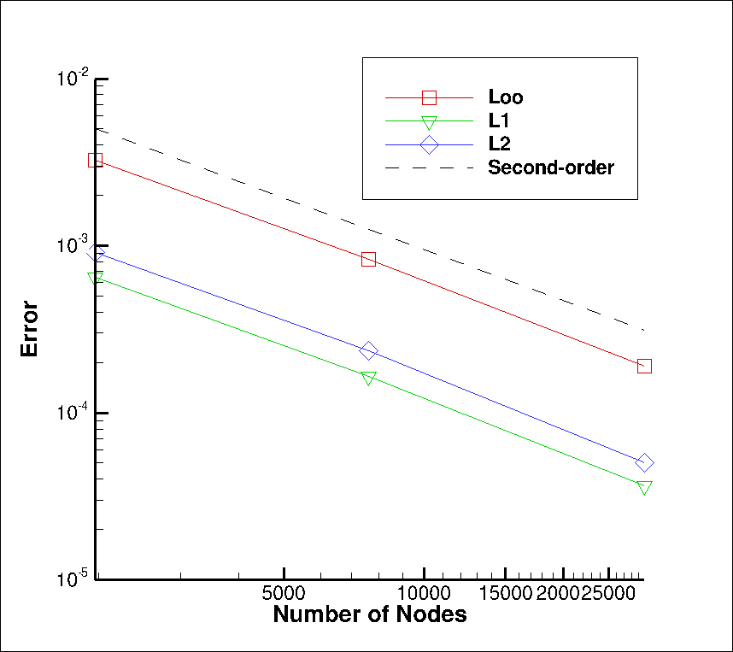
Overset: Freedom for Generalized Motion
Implicit, constraint-based overset-based approach (DG/CVFEM-based, started)
Does not require presumed movement
Similar to Nalu-Wind’s Sharma et al, J. Comput. Phys. (2021), however, STK-based search
BLOCK_2
BLOCK_3 (newly declared and
changed part)
Constraint-based
Fringe
BLOCK_1
Surface_1 (read in)
Surface_101 (newly declared and changed part)
Fluids Hex/Tet
MMS

Slide 20
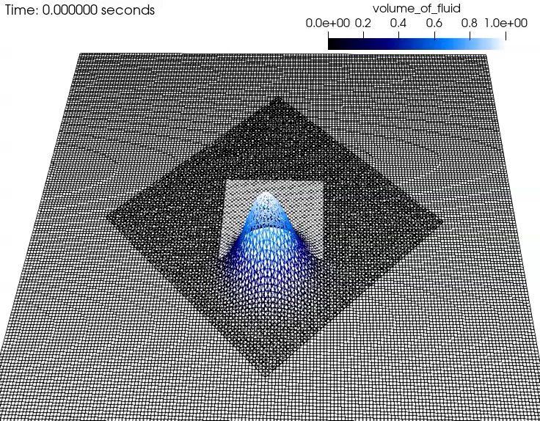
Objective: Overset + Volume of Fluid (VOF)
Molenkamp verification case, now with overset
Static bubble (computed curvature)
Hex8, Tet4, and Hex8/Tet4 Balanced Force
static bubble; density ratio = 1000

Slide 21
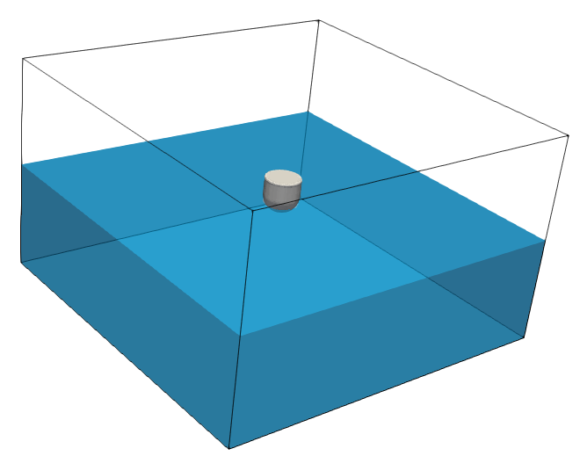

Validation: Unmoored Buoy Drop (Quiescent Conditions)
Comparisons are made to experimental data from the UK Centre for Marine Energy Research (UKCMER) of the WEC vertical displacement given in Ransley et al., Renew. Ener. (2017) who exercised a mesh deformation construct
5 m
5 m
0.5 m
3 m
0.25 m
0.25 m

Slide 22
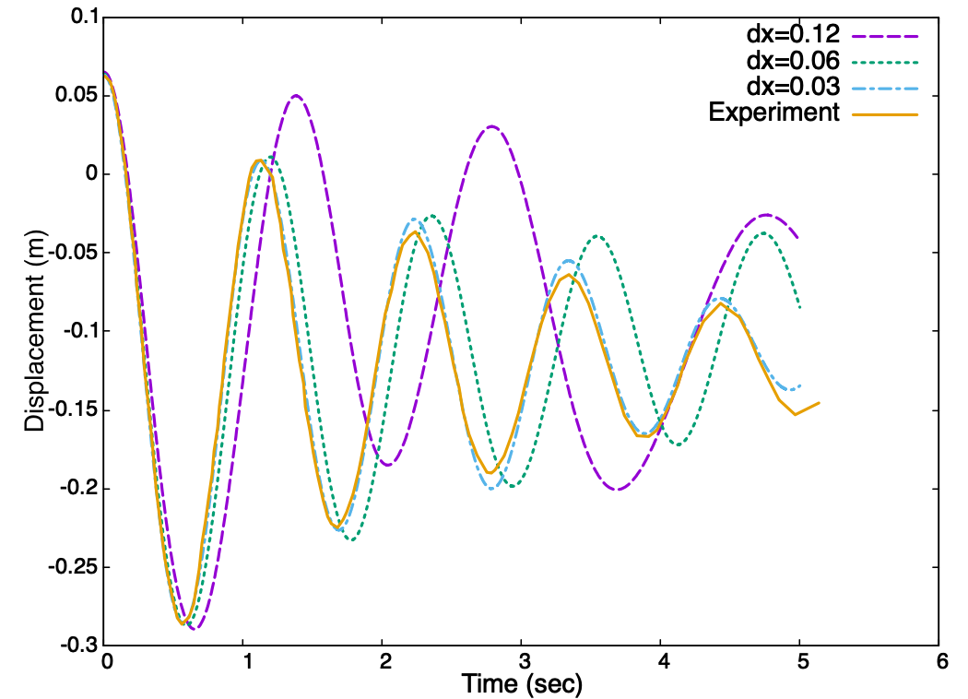
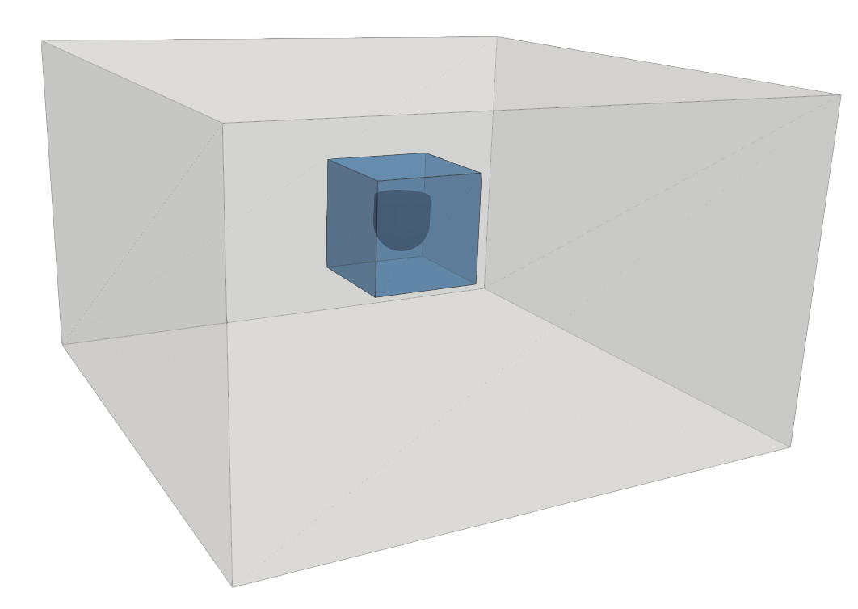
Validation: Unmoored Buoy Drop (Quiescent Conditions)
Objective: Compare to experimental dataset and demonstrate grid convergence
Displaced buoy vertically; QoI: center of mass spatial location as a function of time
Finding: Improved comparison over other works found in literature, e.g., WEC vertical displacement given in Ransley et al., Renew. Ener. (2017)
0.31 m

Slide 23
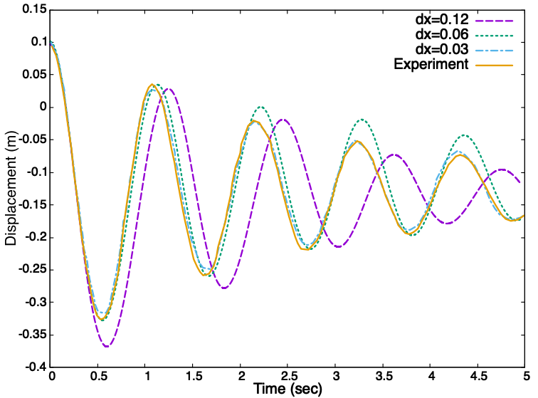
Validation: Moored Buoy Drop (Quiescent Conditions)
Objective: Compare to experimental dataset and demonstrate grid convergence – now tethered
Displaced buoy vertically; QoI: center of mass spatial location as a function of time
Similar Finding: Improved comparison over other works found in literature, e.g., WEC vertical displacement given in Ransley et al., Renew. Ener. (2017)
0.31 m
k = 500 N/m spring force

Slide 24
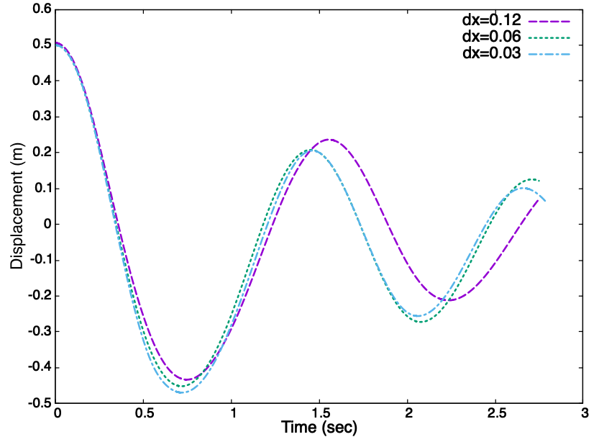
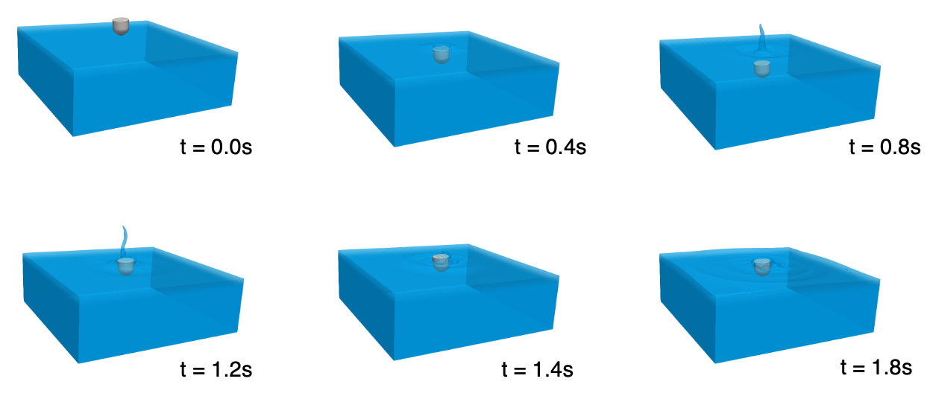
Buoy Dropped Into Quiescent Pool; large displacement limit Validation Benchmark, Domino and Horne, Renew. Energy (2022)
Large-displacement sample case run that can serve as a numerical benchmark

Slide 25
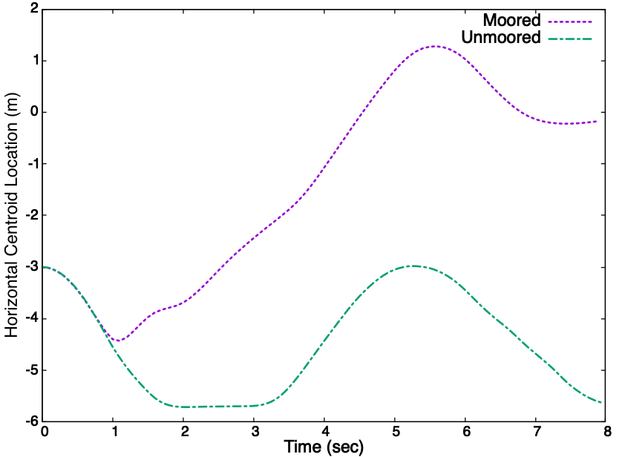
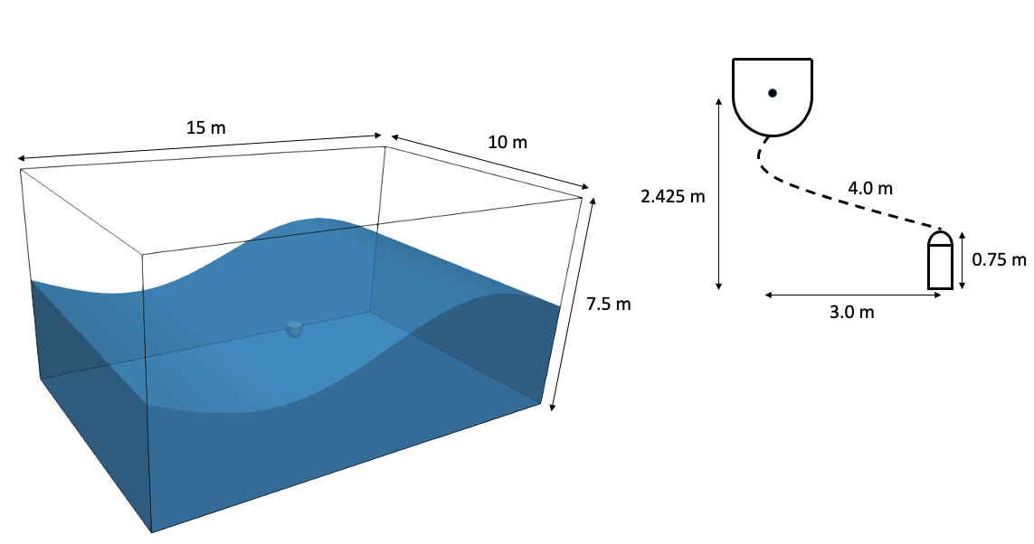
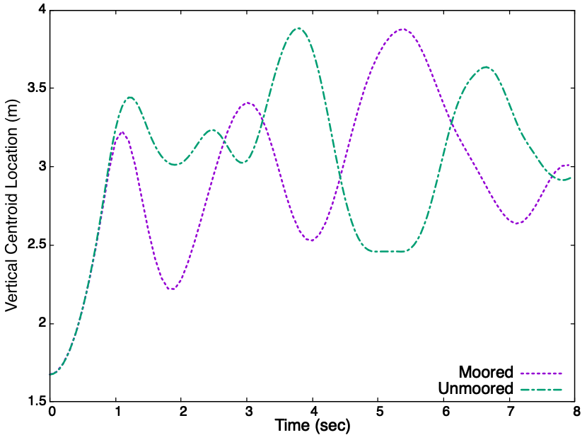
Buoy Subjected to large Wave-Form Validation Benchmark, Domino and Horne, Renew. Energy (2022)
Large-displacement sample case run that can serve as a numerical benchmark for the community; with and without mooring
Geometric center = f(t) relative to the tether’s mounting point

Slide 26
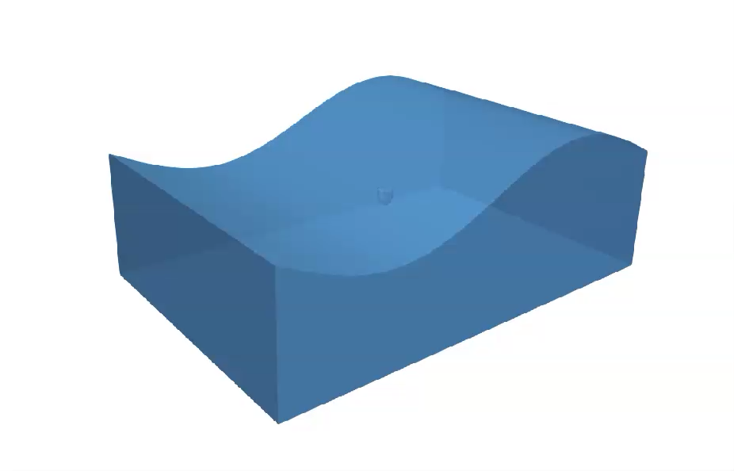
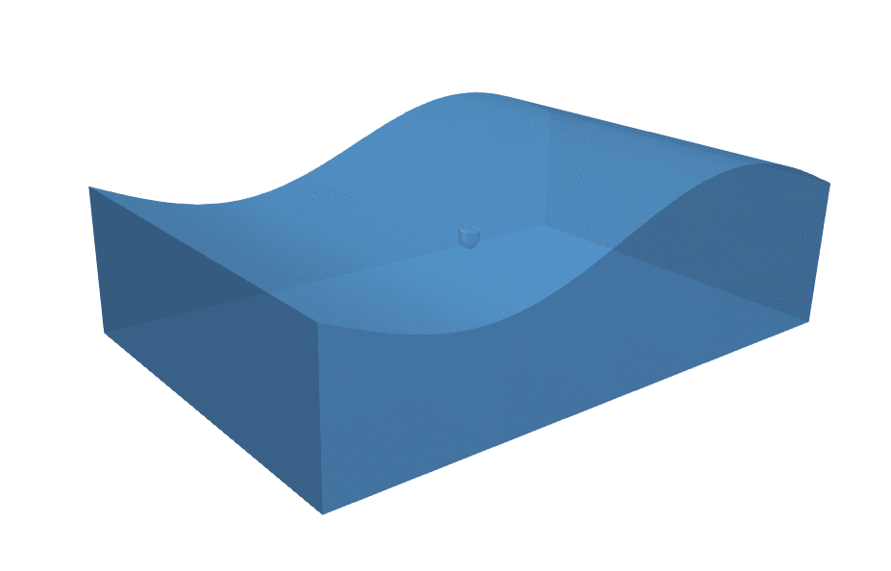
Buoy Subjected to large Wave-Form Validation Benchmark: Without (left) and With (right) Mooring

Slide 27
Re-visit Baseline Formulation: Capillary Instability Mitigation
Explore consistent formulations, i.e., modifications to VOF equation have consequence for momentum and energy transport; diffusive interface (DI); numerical signed-distance function
Jain et al., “A conservative diffuse-interface method for compressible two-phase flows”, J. Comp. Phys. (2020)
Jain, “Accurate conservative phase-field method for simulation of two-phase flows”, J. Comp. Phys. (2022)
Explore alternative CSF → local-CSF (l-CSF)
Mirjalili et al., “Assessment of an energy-based surface tension model for simulation of two-phase flows using second-order phase field methods”, J. Comp. Phys. (2023)
Cast to an “n”, “m”, “c” scheme, c_{M}σκα^{n}(1-α)^{m}$∇α$; c = 1, n = m = 0 reverts to standard CSF
Capillary Instabilities!!
Denner et al., “Artificial viscosity model to mitigate numerical artefacts at fluid interfaces with surface tension”, Comput. Fluids (2017):
$∆t<\sqrt{\frac{ρ_{ave}{Δx}^{3}}{2πσ}}$

Slide 28
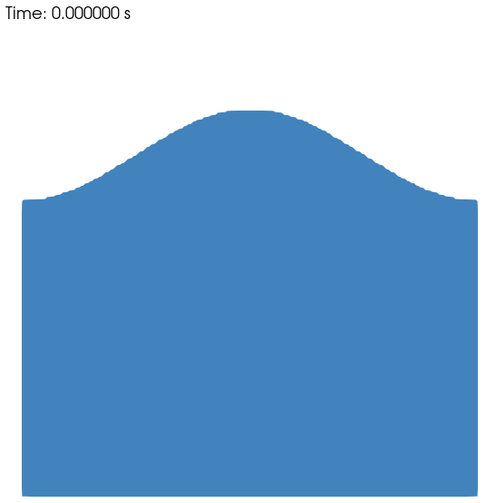

Capillary Instabilities: Interface Evolution
Consistent Jain, J. Comp. Phys. (2022); l-CSF Mirjalili et al., J. Comp. Phys. (2023) noting:
Explicit treatment of the surface tension momentum source term drives a stability limit due to operator-split volume of fluid field, and therefore, curvature (via CSF)
See many works, e.g., Denner et al, Comput. Fluids (2017)
Consider Air/Water (σ = 0.07 N/m; g_{y} = -9.81 m/s²) capillary instability configuration at 100 μm, mesh spacing of 5x10⁻⁷ m
Stability limit Δt ~ 1.0x10⁻⁸ s; initial condition (far left)
100 μm
Δt = 1x10⁻⁶ s
Δt = 1x10⁻⁷ s
Δt = 1x10⁻⁸ s

Slide 29
Capillary Instabilities: Interface Evolution
Post-processed centerline interface height as a function of time
Note that many capillary instability works follow: Popinet, “An accurate adaptive solver for surface-tension-driven interfacial flows”. J Com. Phys. (2009) where density ratio is unity, with varying viscosity and surface tensions, and very small initial amplitude
I will showcase the like-density case a bit later
Height (μm)
Time (μs)

Slide 30
Capillary Instabilities: Path Forward
Denner et al., “Artificial viscosity model to mitigate numerical artefacts at fluid interfaces with surface tension”, Comput. Fluids (2017) outlines a baseline model of,
Raessi et al. “A semi-implicit finite volume implementation of the CSF method for treating surface tension in interfacial flows”, Int. J. Numer. Methods Fluids (2009), where an artificial viscosity is provided, $F_{i}^{σ}=σΔt\left|∇α\right|∇_{s}^{2}u_{i}$; $∇_{s}^{2}$ is the Laplace-Beltrami operator tangential to the interface
Follows the Hysing, “A new implicit surface tension implementation for interfacial flows”, Int. J. Numer. Methods Fluids (2006)
Hysing (2006) implementation, that has it’s roots to a Sandia Goma effort, see: Cairncross et al., “A finite element method for free surface flows of incompressible fluids in three dimensions. Part I. Boundary fitted mesh motion”, Int. J. Num. Methods Fluids (2000)
This operator can be interpreted as an artificial tangential shear stress that damps out instabilities
Monolithic schemes are also postulated where additional DOFs include interface normal and curvature, allowing 100x increase in time steps over the stability limit, see: Denner et al., “Breaching the capillary time-step constraint using a coupled VOF method with implicit surface tension”, J. Comput. Phys. (2022)
This scheme could be implemented within Sandia’s arbitrary coupling/monolithic codes (Sierra/Aria) without too much trouble, however, we would like to avoid fully implicit, monolithic systems including momentum, continuity, VOF, surface normal, and curvature

Slide 31
Capillary Instabilities: Denner et al. (2017) Stabilization
How does this stabilization approach perform?
Looks like we bought a factor of 10 in time step, while the 1x10⁻⁸ results look nearly identical to the non-stabilized scheme
Height (μm)
Δt = 1x10⁻⁶ s
Δt = 1x10⁻⁷ s
Δt = 1x10⁻⁸ s
Time (μs)

Slide 32
Comparison to Analytical Solution: Verification
Following: Popinet, J Comp. Phys. (2009) as presented by Nobel et al., “A Conformal Decomposition Finite Element Method for Dynamic Wetting Applications”, FEDSM2017;
Ohnesorge number Oh = μ /(σ ρ λ )1/2 = 1/√3000
Dimensionless viscosity ε = μ κ 2 /(ρ ω₀ ) = 6.47 × 10⁻²
ω₀ = 1; like density and viscosity between the phases
For this configuration (domain unity in height and width), the time step taken was ~25x higher than the stability limit (including capillary stabilization)
Use this case to explore alternatives to curvature calculations, Jain, J. Comput. Phys. (2022) and inclusion of a diffuse interface approach

Slide 33
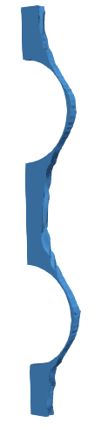

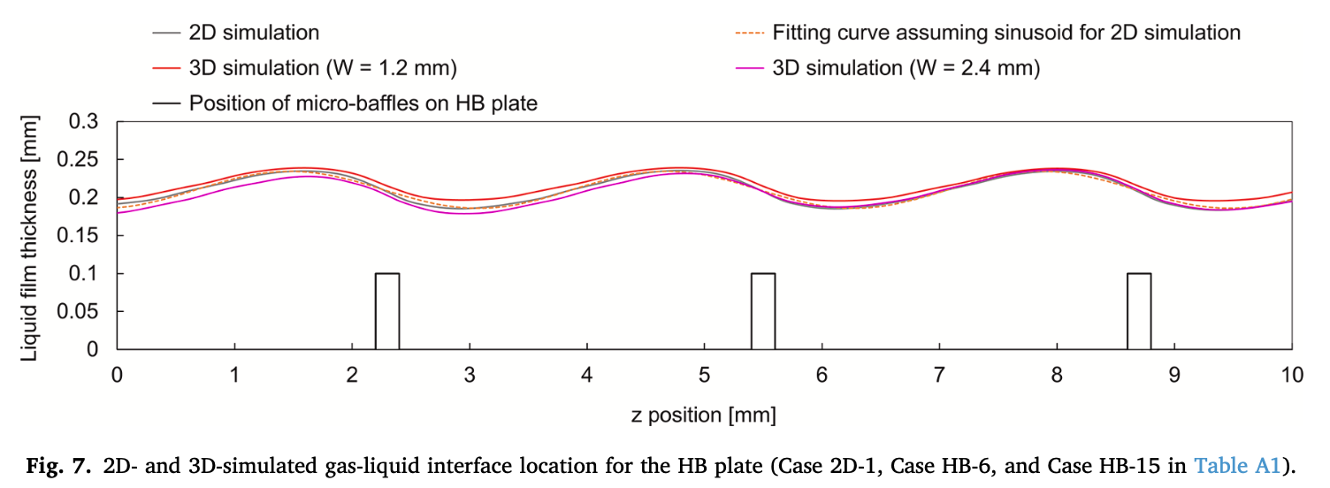

Realistic Flows of Ishikawa et al. Chem. Engr. Process (2022)
Ishikawa et al., “Numerical study on mass transfer in a falling film on structured plates with micro-baffles”, Chem. Engr. Process (2022) motivated falling film simulation result (a) at 0.035 seconds depicting the 90º (b) and 45º (c) unrotated configuration (image scaled in x-direction) 0.1 mm (100 μm) baffle heights
Capillary stabilization activated; localized CSF, consistent momentum source term
The time step roughly 13 times the stability limit
Now stable at
the 100 μm scale!
(b)
(a)
(c)

